Slide 1

Amazon S3 Storage
GTech

Slide 2
Agenda
Introduction to Amazon S3
Amazon S3 Storage Classes
Amazon S3 Lifecycle Rules
S3 Storage Class analysis
Amazon S3 Replication
Amazon S3 Object Encryption
AWS KMS and Its Limitations
Amazon S3 Client-Slide Encryption
Comparing S3 Encryption Methods
Amazon S3 Access Logs
Summary

Slide 3
Introduction to Amazon S3
Amazon S3 stands for Simple Storage Service
It is an object storage service provided by AWS
Data is stored as objects inside buckets.
Objects can include image, video, documents, and backups.
Different storage classes suit different access needs.
S3 provides lifecycle management, replication and encryption

Slide 4
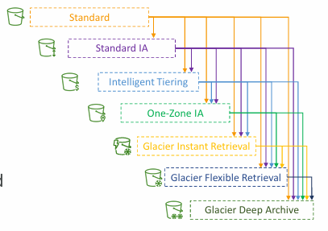
Amazon S3 Storage Classes
S3 Standard: For frequently accessed data.
S3 Intelligent-Tiering: Automatically moves eligible data between access tiers.
S3 Standard-AI: For infrequently accessed data needing immediate retrieval.
S3 One Zone-IA: For infrequent data that does not need multi-AZ resilience
S3 Glacier Classes: For archive and long-term storage

Slide 5
Amazon S3 lifecycle Rules
Lifecycle rules automate actions on stored objects.
Transition: Moves eligible objects to another storage class.
Expiration: Schedules eligible objects for detection.
Rules can apply to all objects or selected objects.
Filters can use prefixed and object tags.
Rules can also help remove incomplete multipart uploads.

Slide 6
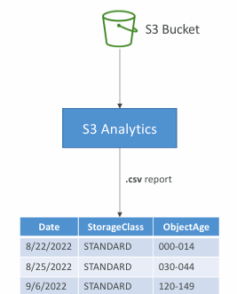
Amazon S3 Storage Class Analysis
Helps understand how objects are accessed over time.
Supports decisions about storage class selection
Can help identify data suitable for infrequent access
Analysis results can be delivered in a CSV report.
It helps inform lifecycle rule planning.
It does not automatically move objects.

Slide 7
Amazon S3 Replication
Replication automatically copies eligible objects between S3 buckets.
SRR: Same-Region Replication
CRR: Cross-Region Replication
Versioning must be enabled on both buckets for live replication.
Replication requires appropriate permissions and configuration.
It supports resilience, data sharing, and recovery planning.

Slide 8

Amazon S3 Object Encryption
Encryption protects stored data from unauthorized reading.
Encryption at rest: Protects data while stored.
Encryption in transit: Protects data during transfer.
SSE-S3: S3 manages encryption keys.
SSE-KMS: Uses AWS Key Management Service.
Other options include DSSE-KMS, SSE-C, and client-side encryption

Slide 9
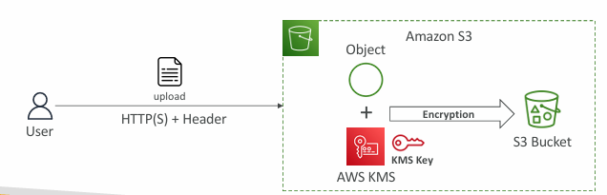
AWS KMS and Its Limitations
AWS KMS helps create and manage encryption keys.
SSE-KMS integrates S3 encryption with KMS
Key policies and IMA permissions control key access.
KMS requests are subject to quotas and rate limits.
High request rates may cause throttling.
Cross-account access requires correct permissions and key policies.

Slide 10
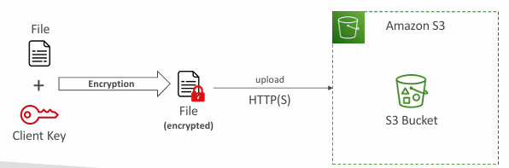
Amazon S3 Client-Side Encryption
The client encrypts data before uploading it to S3
S3 stores the encrypted object
The client decrypts the object after retrieval
The customer manages the required encryption keys
Losing the key may make data unrecoverable.
Losing the key may make data unrecoverable.
HTTPS is still important for secure data transfer.

Slide 11
Comparing S3 Encryption Methods
SSE-S3: S3 manages encryption and keys.
SSE-KMS: Integrates with KMS for key control and auditing.
DSSE-KMS: Provides two layers of server-side encryption.
SSE-KMS: Provides two layers of server-side encryption.
Client-Side encryption: Application encrypts before uploading.
Choose based on security, control and management requirements.

Slide 12
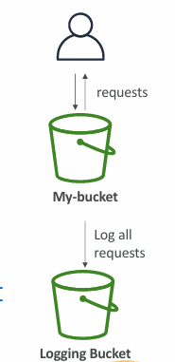
Amazon S3 Access Logs
Server access logging records requests made to an S3 bucket.
Logs can include requester, time, operation and status details.
Helps investigate access issues and understand usage.
Logs are delivered to a configured destination bucket.
Destination permissions and configuration must be correct
Log delivery is not necessarily immediate

Slide 13
Summary
Amazon S3 stores objects inside buckets.
Storage classes support different access patterns and budgets.
Lifecycle rules automate transitions and expiration.
Replication copies eligible objects between buckets.
Encryption protects data and requires appropriate key management
Access logs help investigate S3 requests and usage.

Slide 14


